Slide 1
Exploring Around the World
Unified Fall Event at Martin School, Seekonk 2020

Slide 2
Set Up
Cohort A- Little Stars
6 students- 12 5th Grade buddies
7 continents with activities set up in gym with decorations
Backpacks, explorer badges- other props
Cohort B- Upper Stars
4 students- 8 5th grade buddies
7 continents with activities set up in the gym with decorations
Backpacks, explorer badges- other props
Prior to event- Stars students will practice activities to ensure familiarity and will meet 5th grade buddies
Event time can vary based on availability and stamina of participants.
Minimum time would probably be 1 hour.

Slide 3
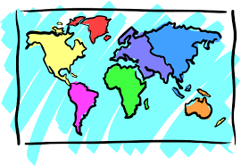
Continents with Activities

Slide 4
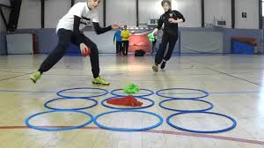
Antarctica
Frozen Tic Tac Toe
Description:
Explorers will be divided into two teams
One team is the blue icebergs and the other is the white icebergs
Teams will run up to giant tic tac toe board made from hula hoops and place an iceberg one piece at a time in a hoop
Teams may also move a piece instead of placing a new one on their turn.
First team to get 3 in a row wins
Materials Needed:
9 hula hoops
Blue icebergs
White icebergs

Slide 5
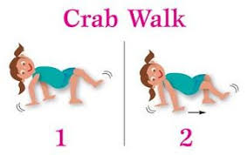
Africa
Animal Relay Races
Materials:
Cones for starting line and ending line
Description:
Explorers will go from starting line to ending line moving like the animal that is called out
When all Explorers on the team have finished that team wins.

Slide 6
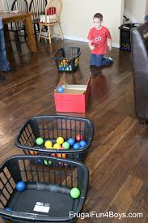
Australia
Kangaroo Toss
Materials:
Soft Balls (dodge balls) decorated like a joey
Baskets decorated like a kangaroo
Description:
Explorers will take turns tossing a “Joey” back to it’s mom by getting it in the basket
Each explorer will get a turn

Slide 7
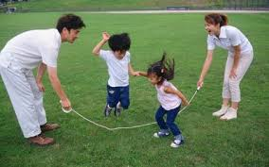
North America
River and Mountain Jumping
Description:
Explorers will take turns jumping over the mountains (made by moving jump rope up and down on the floor) and the rivers (made by moving jump rope side to side on the floor)
All explorers get the chance to cross
Materials:
Long Jump ropes

Slide 8
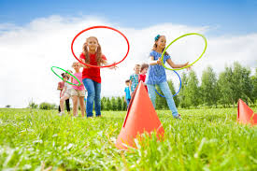
Europe
Taming the Mountains
Description:
Explorers will each take a turn trying to tame a mountain by tossing a hula hoop over it.
Each explorer will be given two turns
Materials:
Large Cones
Hula Hoops

Slide 9
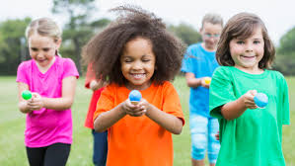
Asia
Spice Run
Materials:
Spoons or ladles (depending on explorers)
Small Buckets
Beans or small balls
Description:
Explorer teams will work to transport their spices (ball or beans) to their bucket
Activity will be timed and spices counted at the end.

Slide 10
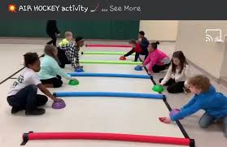
South America
Air Hockey
Materials:
Pool noodles (2 per lane)
Tape
Small cones
Bean bags
Description:
Explorers will play with their buddies and each buddy with have a turn
Explorers will face another explorer team
Explorers will use the cones to pass the bean bags back and forth trying to score a goal
Each explorer will have a turn of 1-2 minutes depending on time

Slide 11
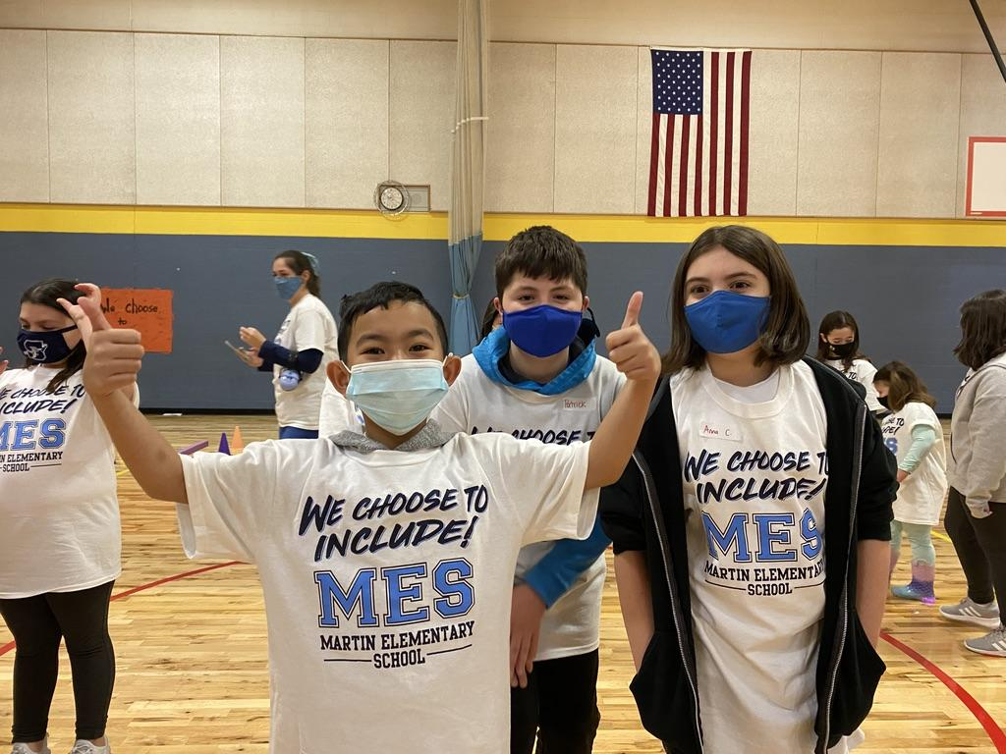
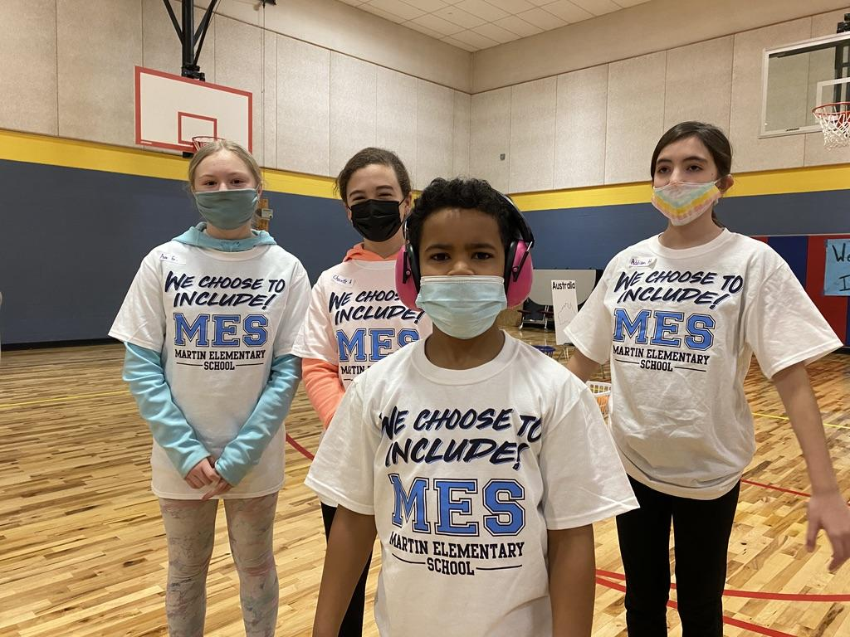
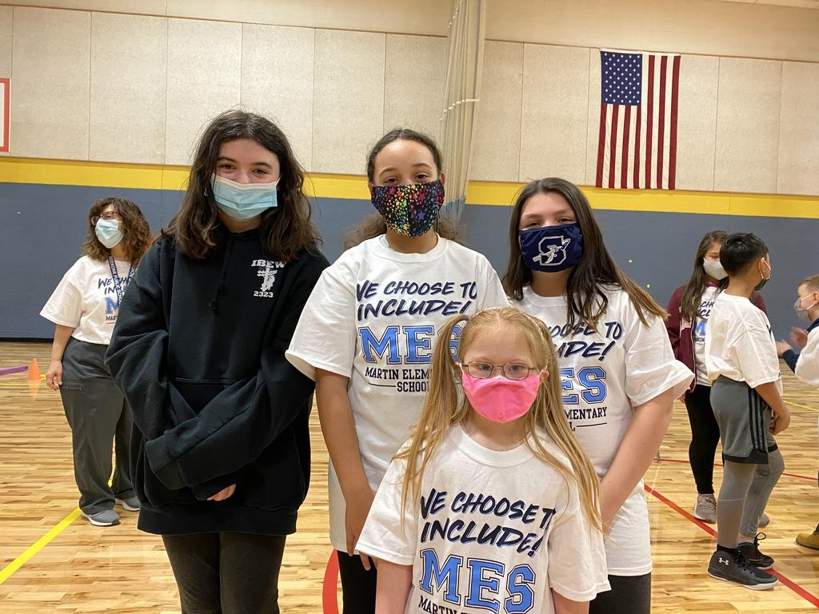

Slide 12
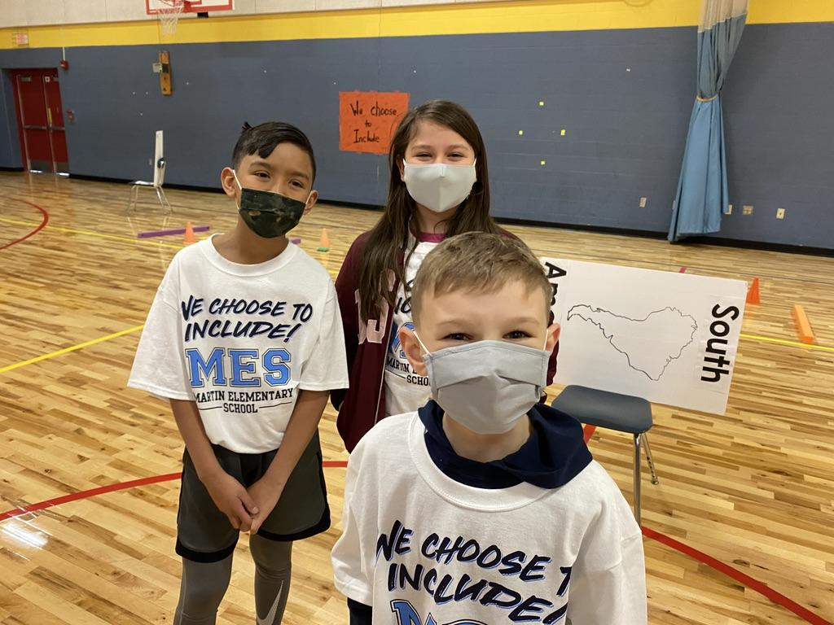
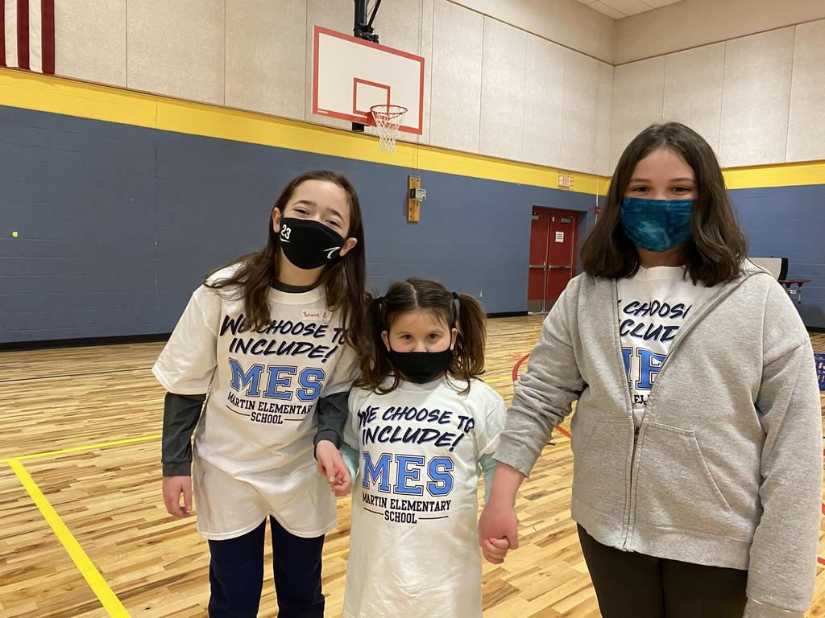
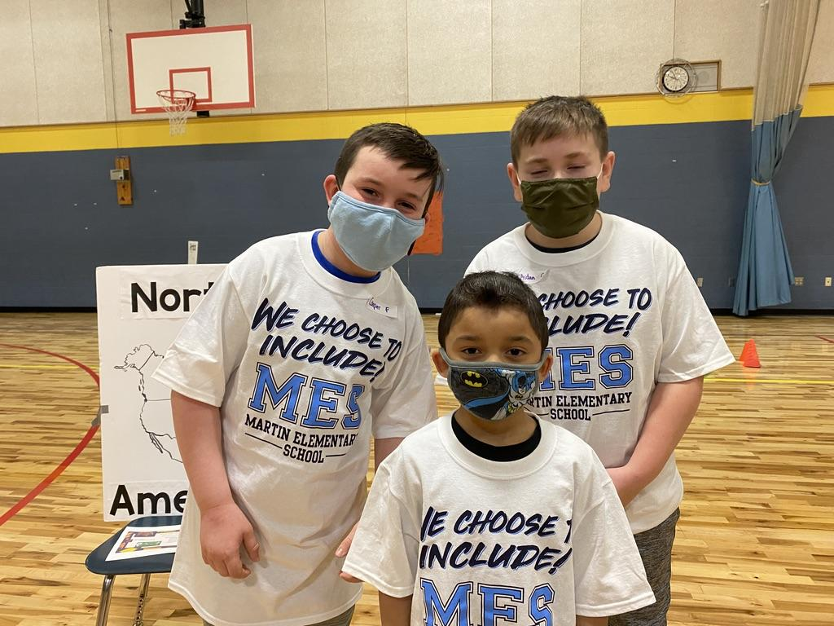

Slide 13
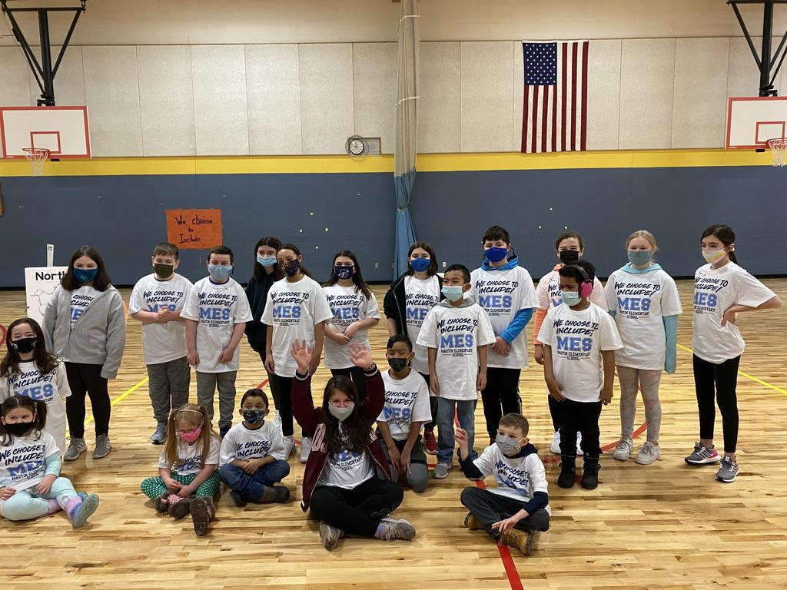
We Choose to Include!!

Slide 14
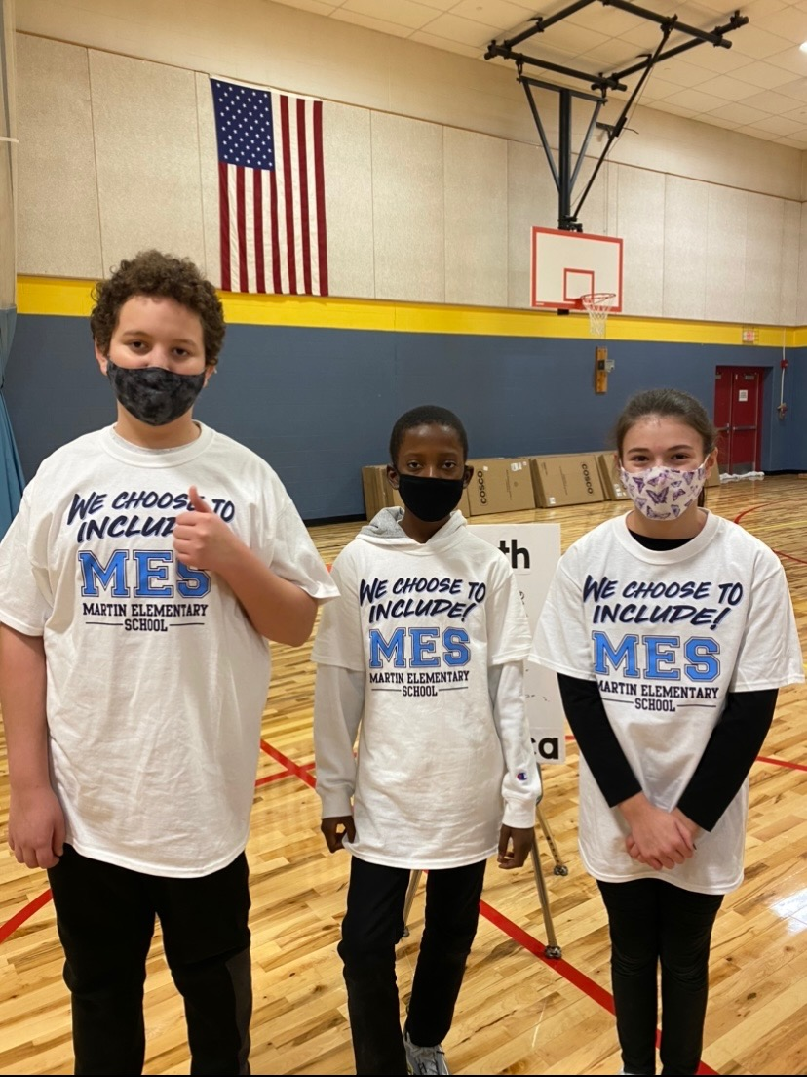
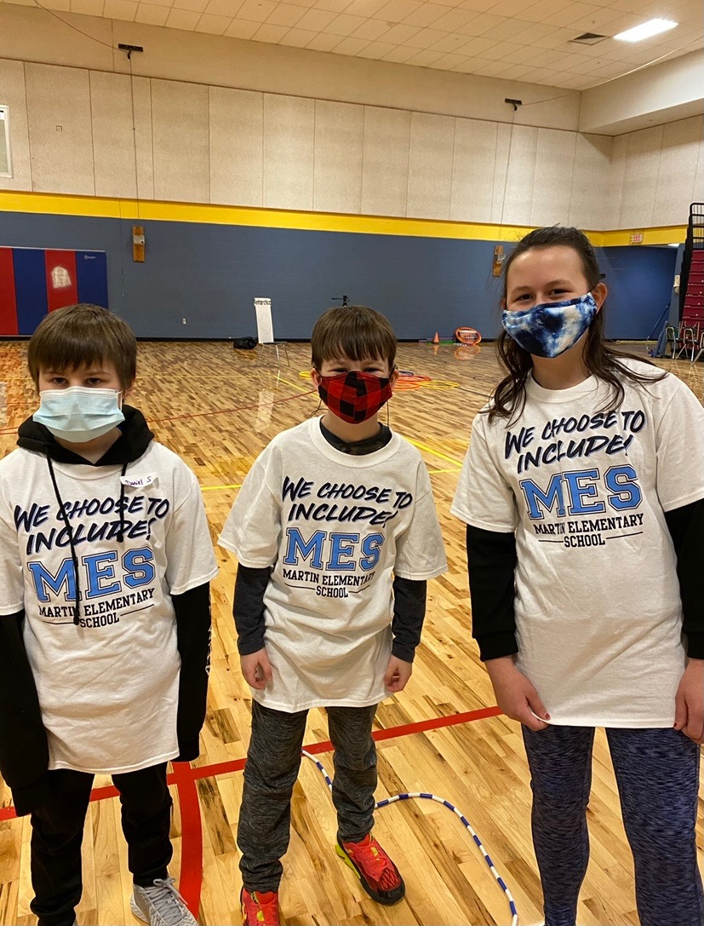
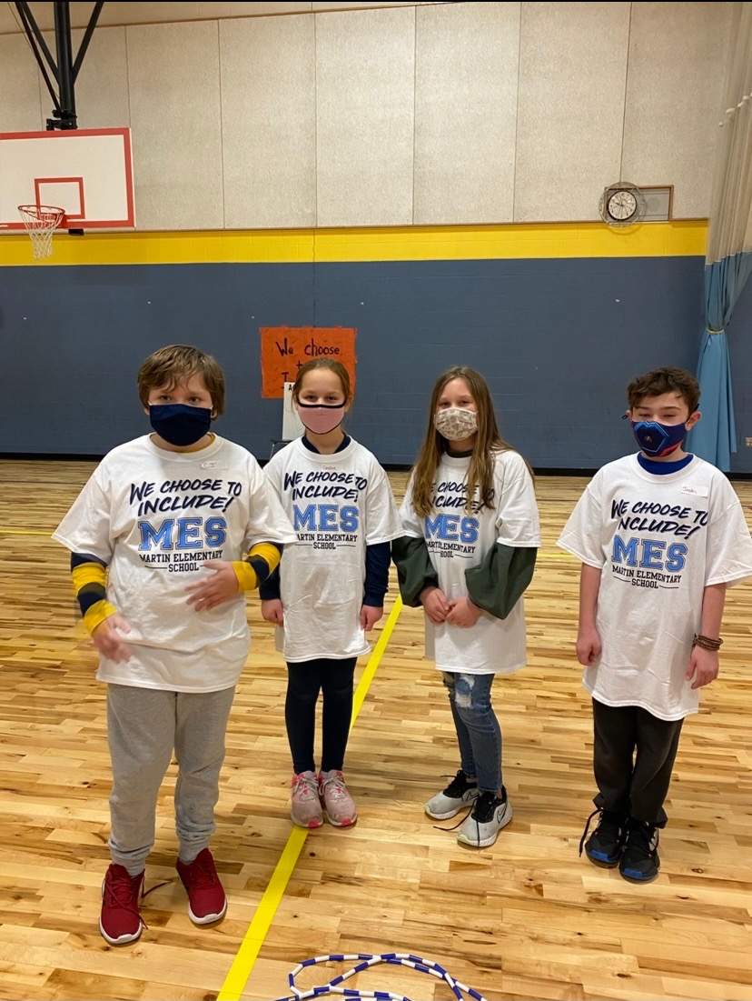
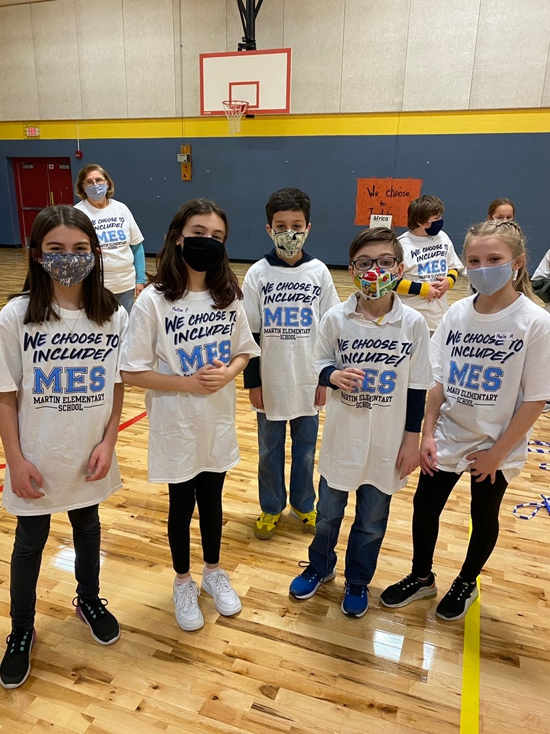

Slide 15
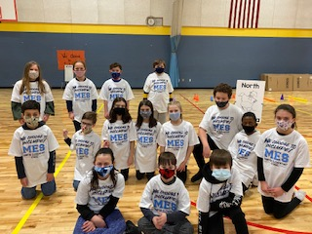
We Choose to Include!!

